Slide 1
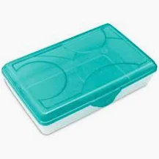
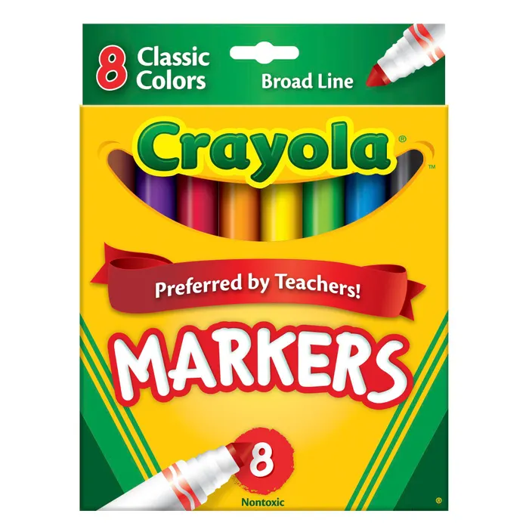
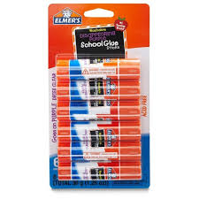
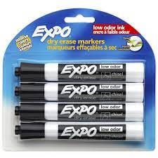
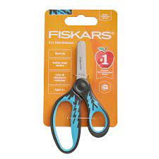
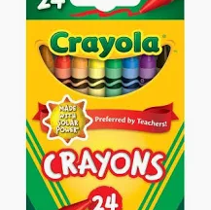
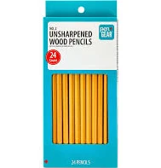
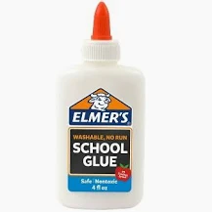
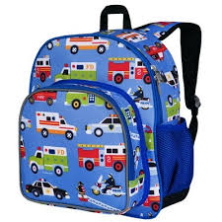
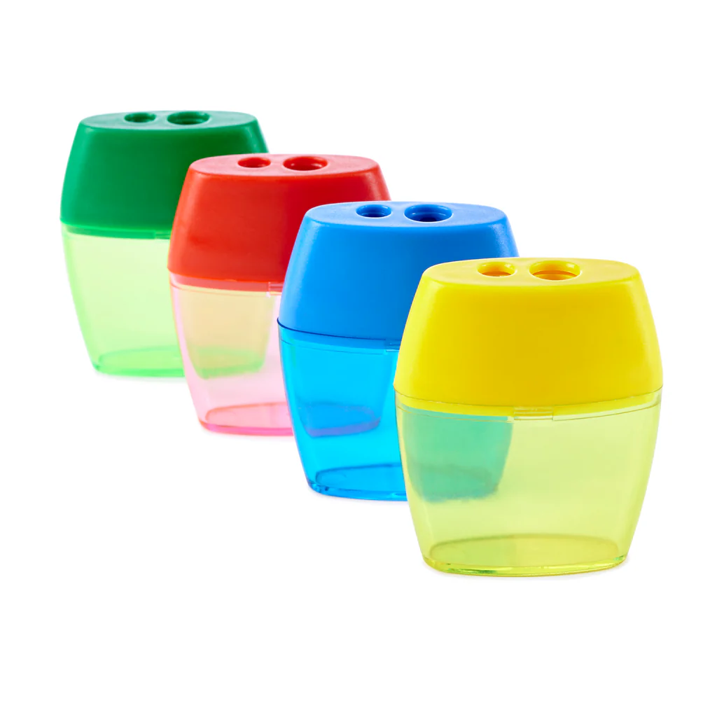
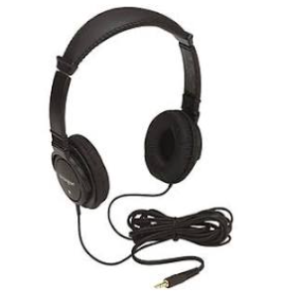
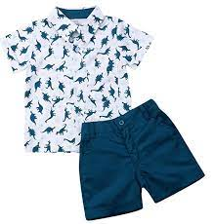
Mrs. St George’s Supply List
Dear Parents,
Welcome to a new year of learning and creativity! Here’s what your child will need to bring.
Thank you!
–Mrs. St. George
Pencil Box
Markers or Colored Pencils
Glue Sticks
Dry Erase Markers
Small scissors
Crayons
Pencils
Liquid Glue
Backpack
Pencil Sharpener
Head-phones
Change of Clothes in zip-top bag
**water bottle is optional**

